Slide 1
Prediction and Estimation Model for the Taxi’ driver in the Airport area
TEAM MEMBERS:
NGHI LU MINGYU LYU
ZIYI ZHONG HONG TANG YA CHEN TSAI
ECE 143: TEAM 6

Slide 2
References
https://www.flightera.net/en/airport/Shanghai/ZSPD/departure/2018-04-01%20%2008_00
https://www.google.com/maps
http://www.google.com
https://machinelearningmastery.com/how-to-configure-k-fold-cross-validation/

Slide 3
Purpose of Making This Project
The purpose of this project is to help out taxi’ drivers (in this case we will use the Data set from Shanghai government in 2018 and flights data manually imported from flight tracking website) to decide whether they should stay at the airport waiting for the passengers or go to Downtown to wait for other passengers based on the projected wait time and the cost of a operating consumption.

Slide 4
Overview
Process the data that we have collected and written functions that could work with the ideas that we came up with
Built a prediction model for taxi drivers based on the waiting time data that we have collected.
Built the recommender model to decide whether the taxi’s drivers should wait or leave the Airport.
Data visualization.

Slide 5
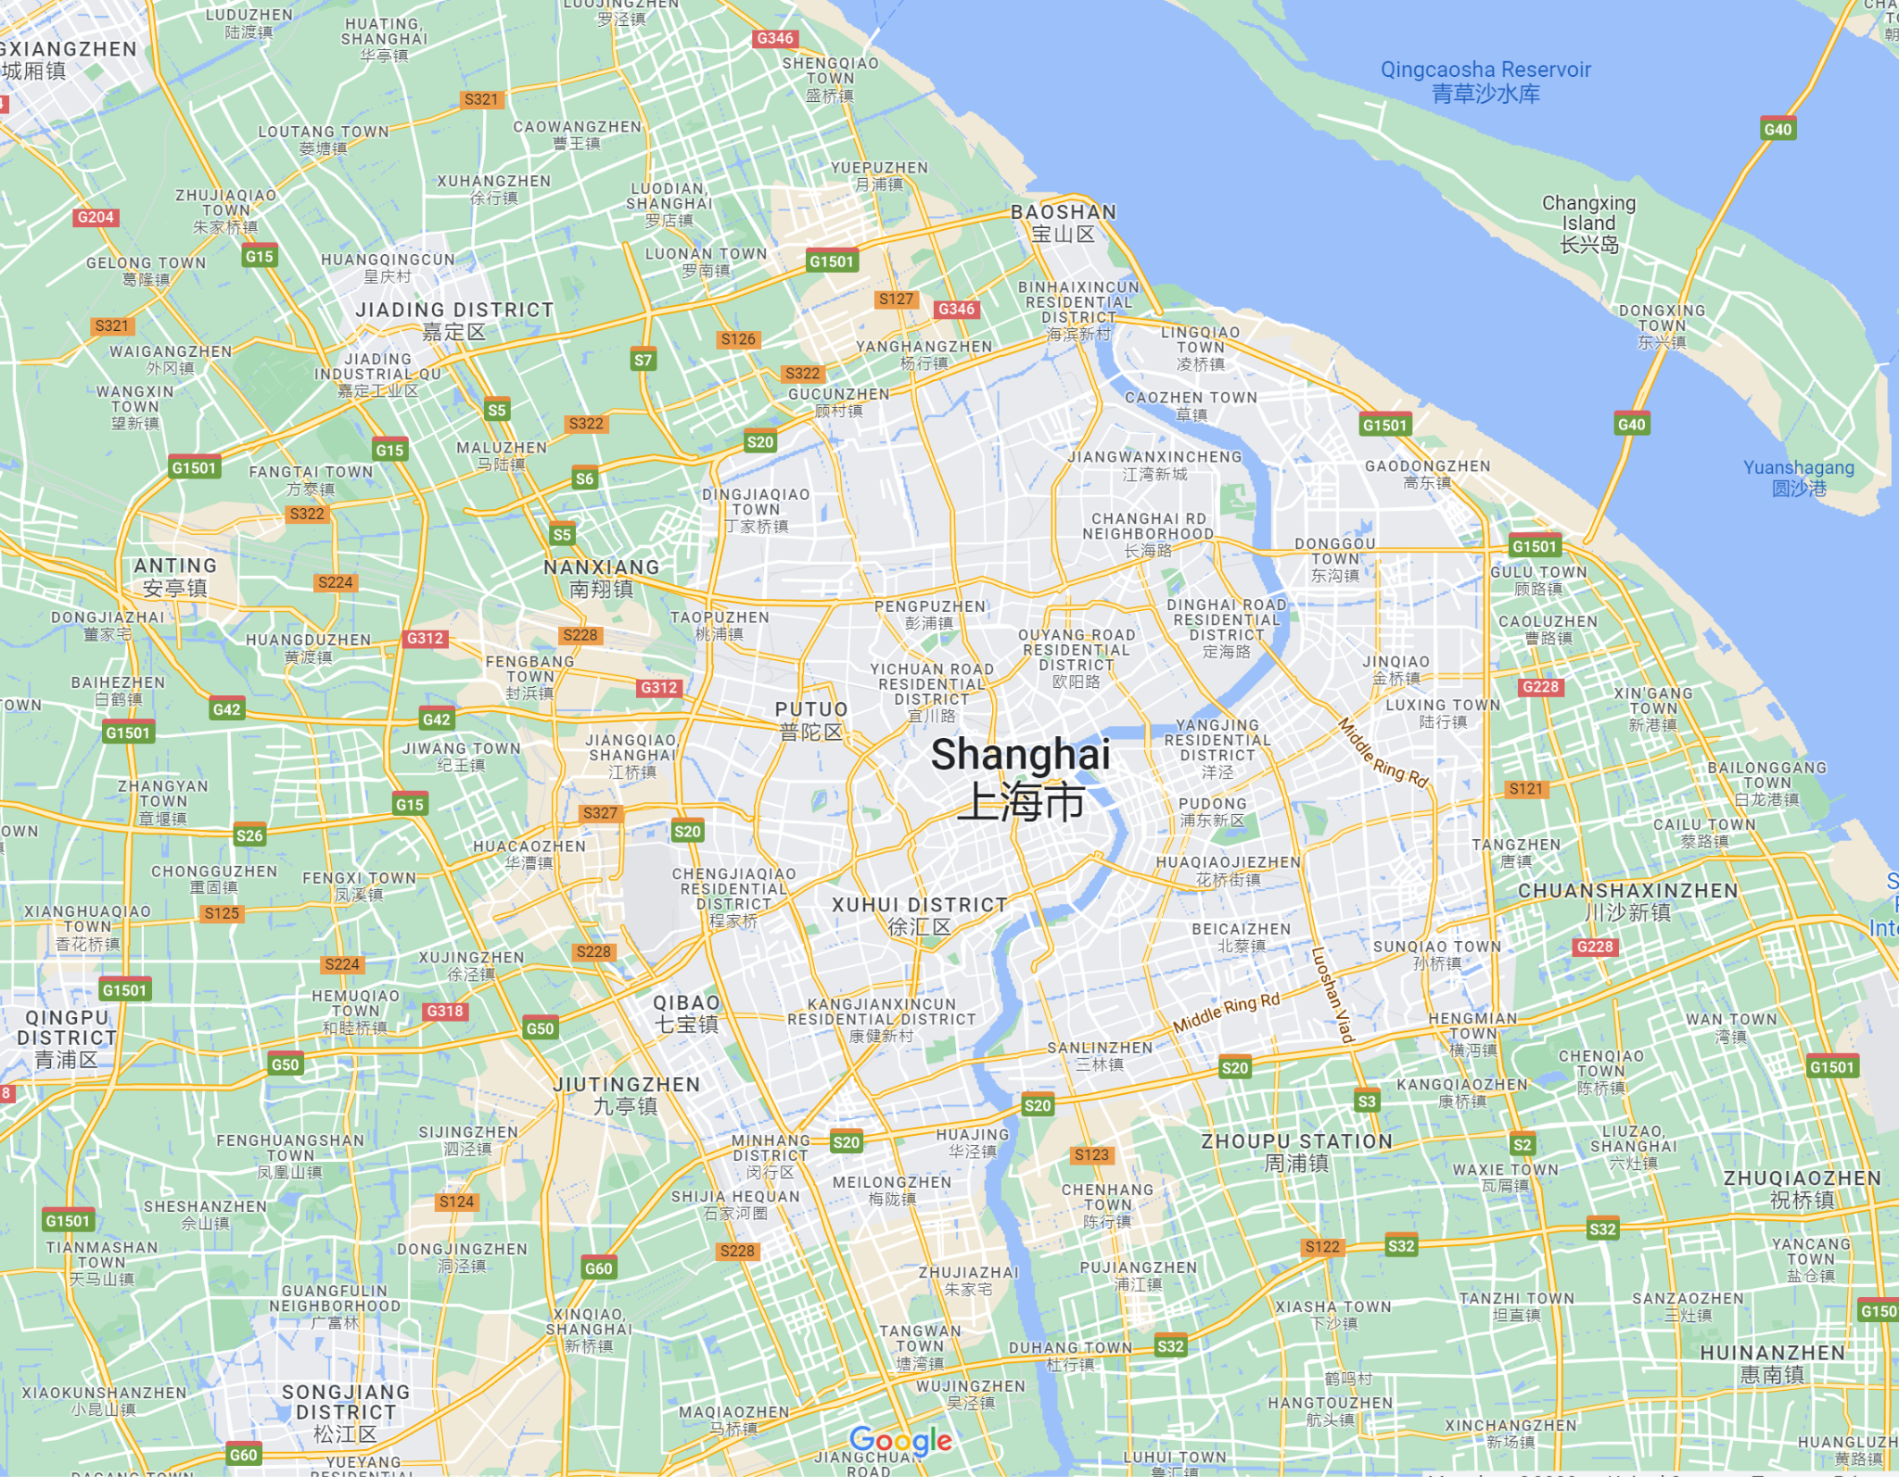
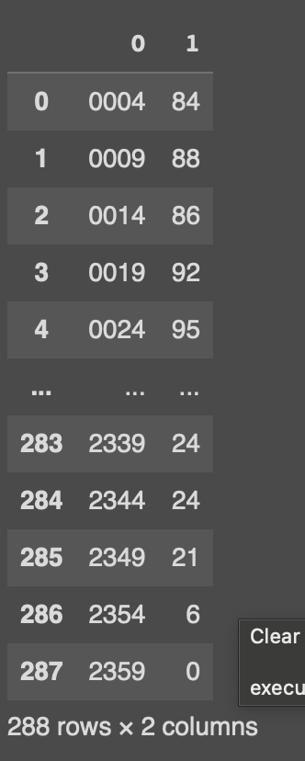
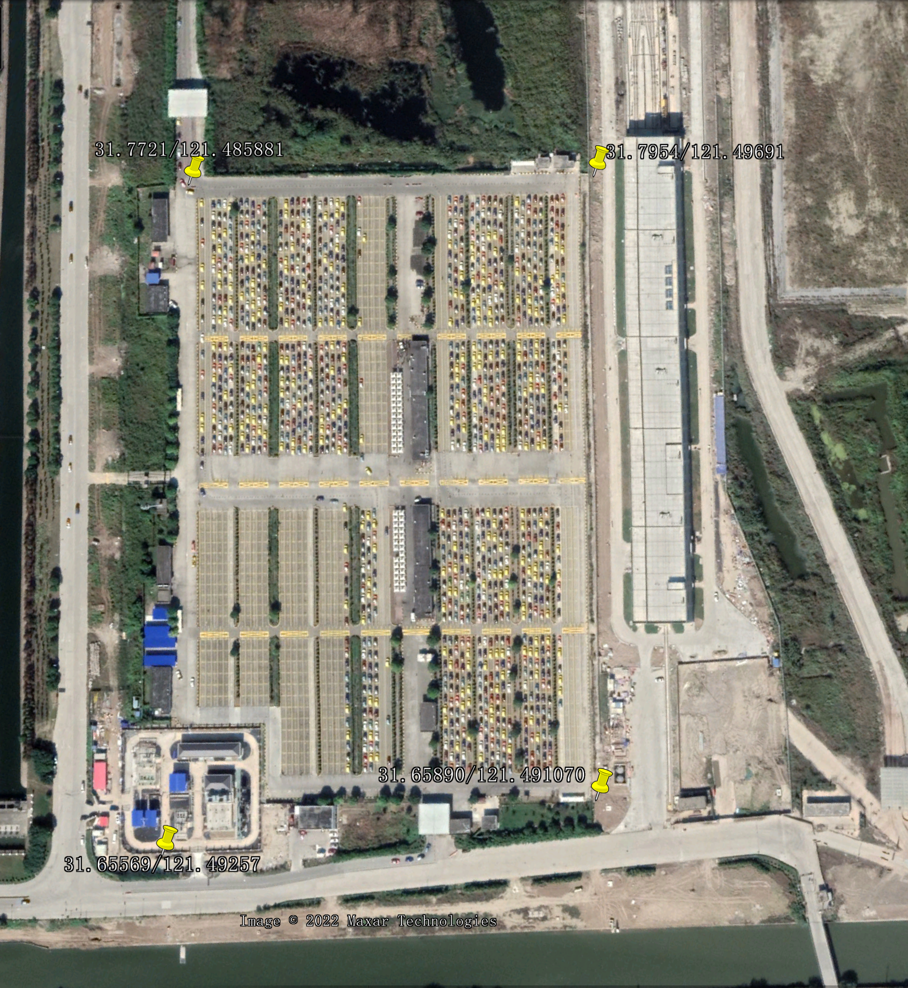
How this works?
We divided the flight data set into 288 time slots that worth 5 minutes per time slot. This time slot will be used to keep track of how many taxi cabs are in the parking lot area of the Airport.
Writing function to locate the location of the parking, so when the taxi(s) come into the area, the system will count how many cab(s) in total are in the parking lot for each time slot.
We also write function to define the Downtown area in case if the taxi driver(s) decided to go back to pick up passengers from there.

Slide 6
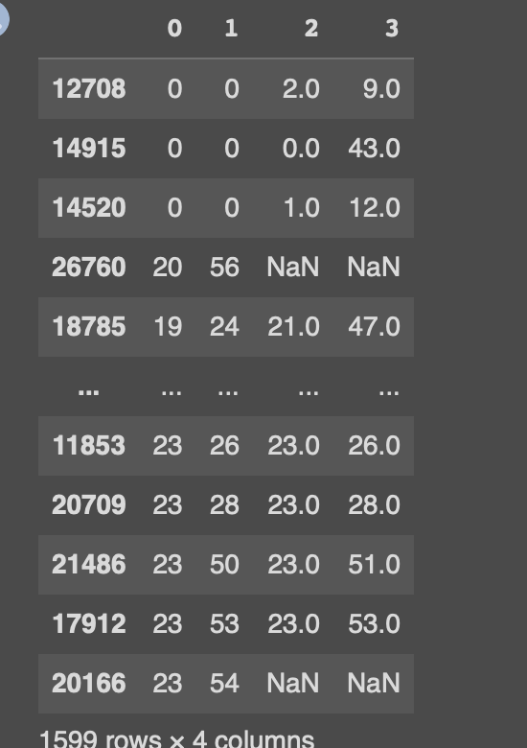
Wait time of each cab
Columns: ID of each taxi cab
0: entry hour
1: entry minute(s)
2: exit hour
3: exit minute(s)
NaN needed to be filtered out

Slide 7
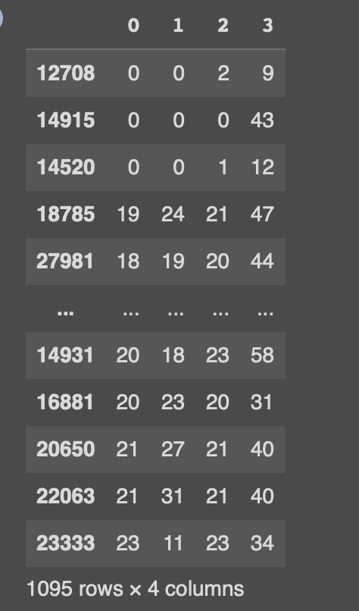
Final wait time data frame
After filtering out the unwanted data values, we converted the values into integer to easy to work with.

Slide 8
How it works?
After creating a dataframe, we created the following variables:
x1: each car’s entry time to the airport parking lot.
x2: total cabs in the parking lot at a specific time slot
x3: total flights in the specific time slot
y: the average wait time in that time slot
Using all the x(s) and y(s) values we need to train our model.
[[0, 84, 22], [0, 84, 22], [0, 84, 22], [232, 243, 34], [219, 229, 27], [243, 252, 40], [0, 84, 22], [125, 163, 33], [145, 196, 25], [0, 84, 22]]
[160.75, 160.75, 160.75, 145.7273, 138.6364, 213.375, 160.75, 290.0, 221.1429, 160.75]

Slide 9
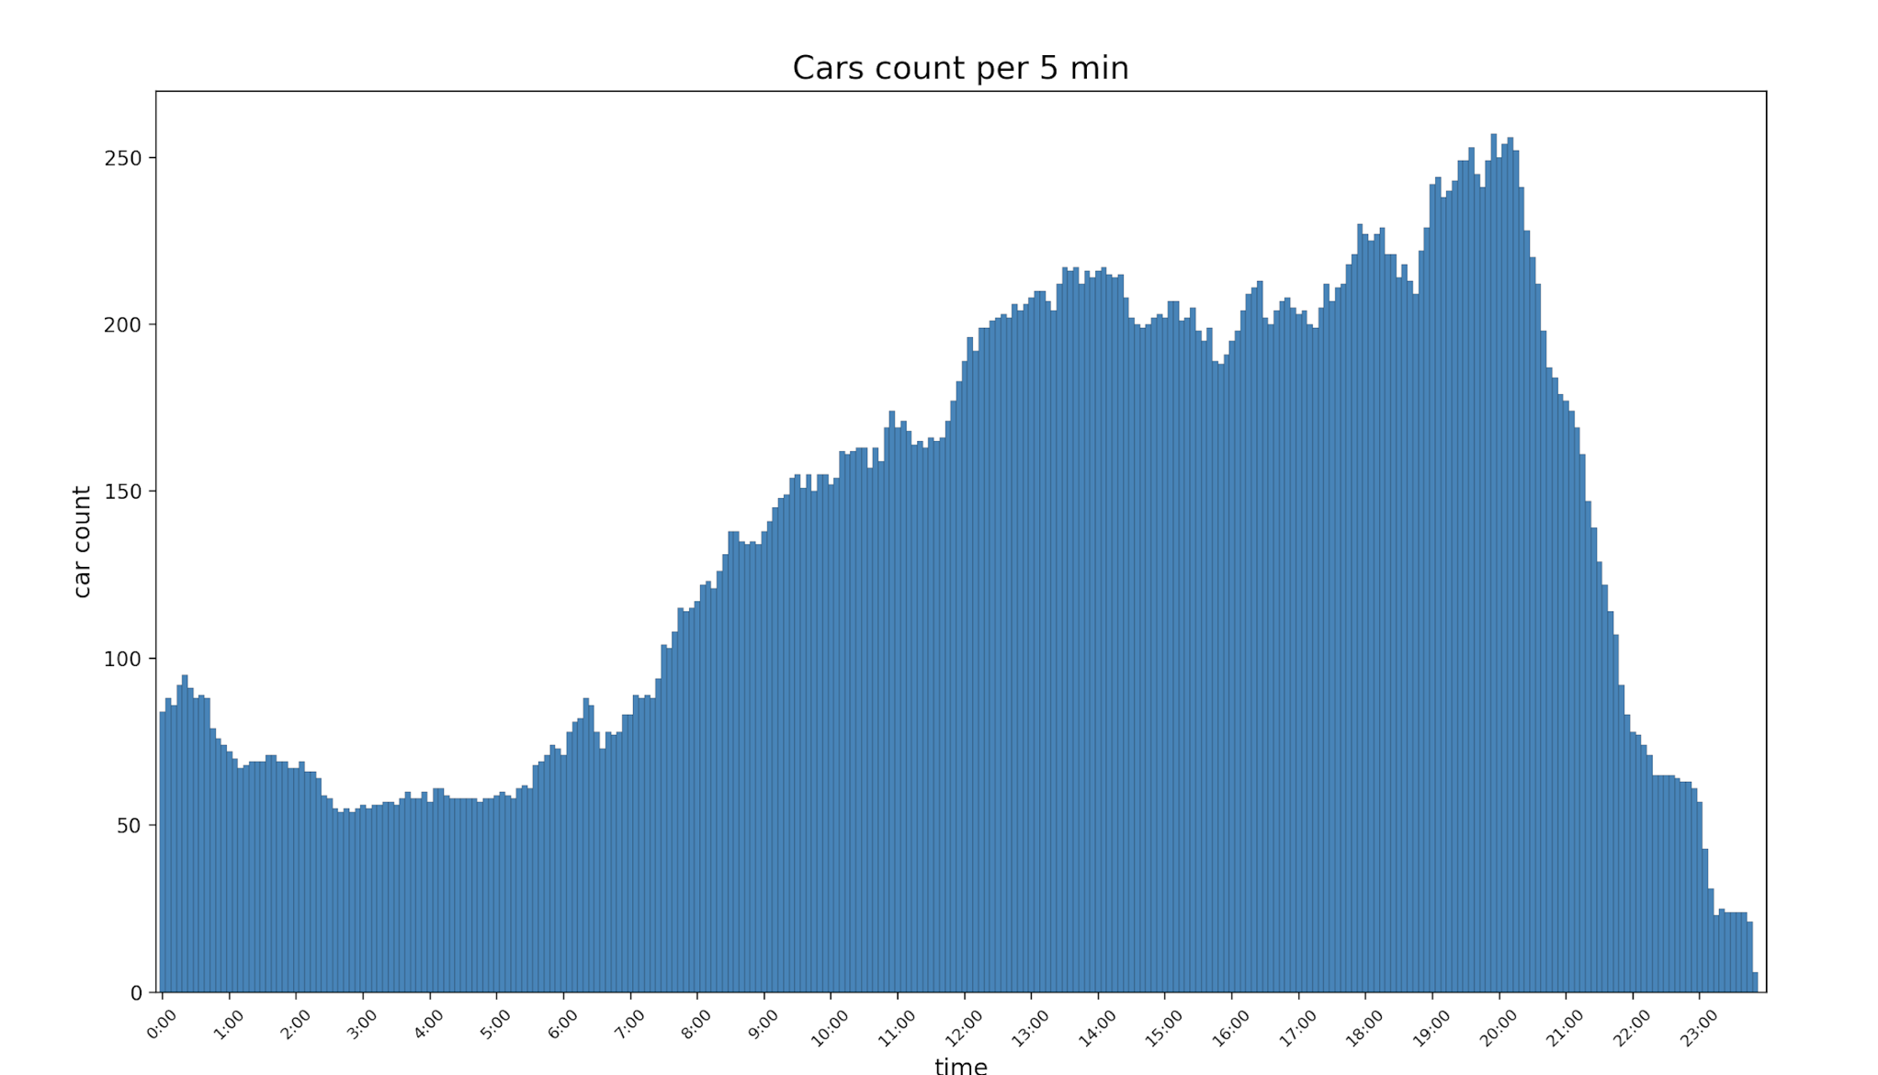

Slide 10
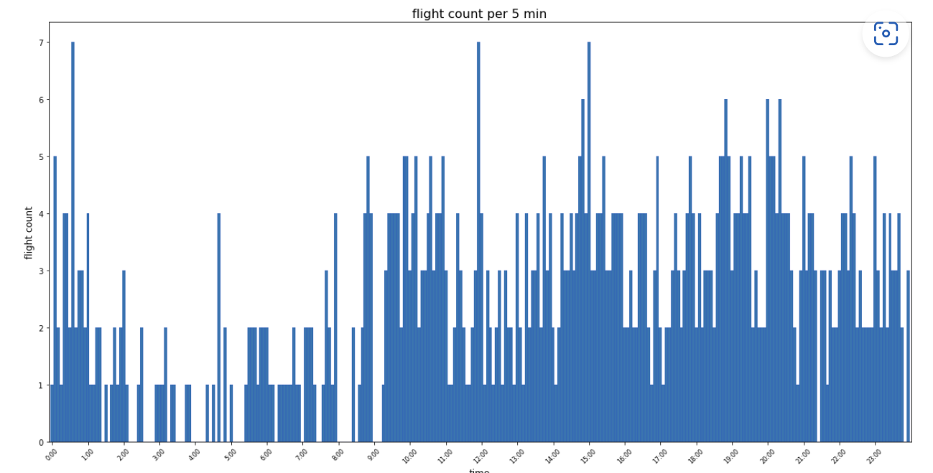

Slide 11
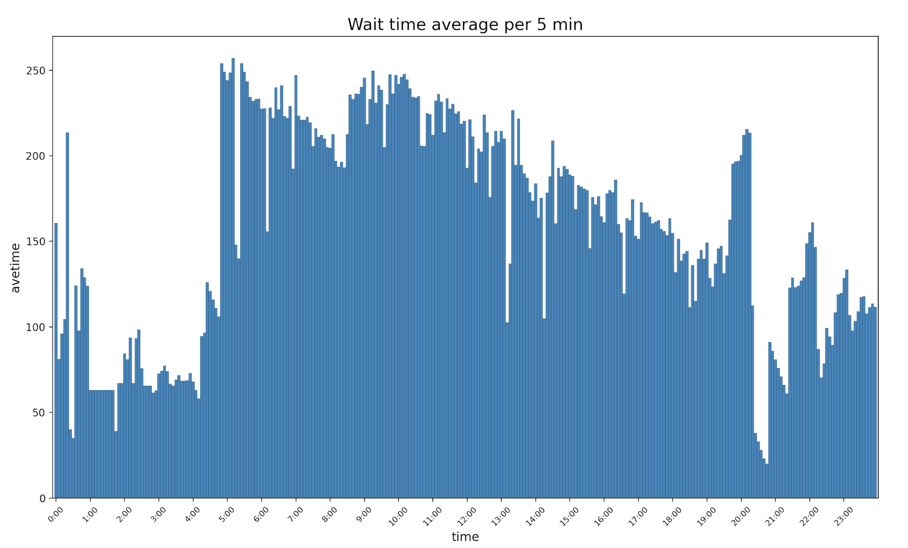

Slide 12
Models training’ graph
Using the third party module from Python (sklearn, mlt), we plotted a couple graphs with different results.
After removing the outliers, we could see that the results were more accurate than before
By experimenting, we compared and selected the suitable models.

Slide 13
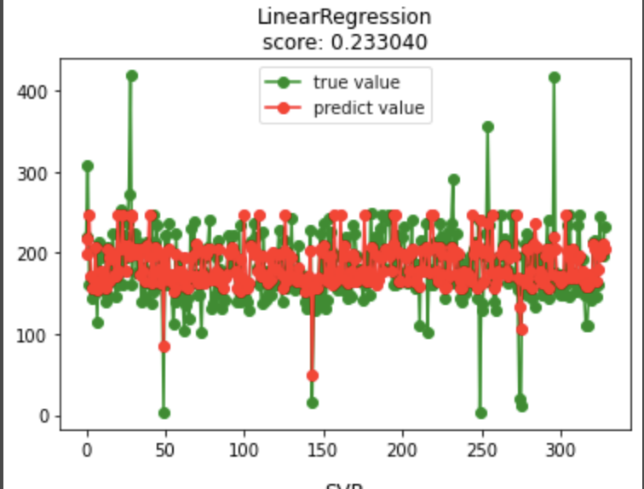
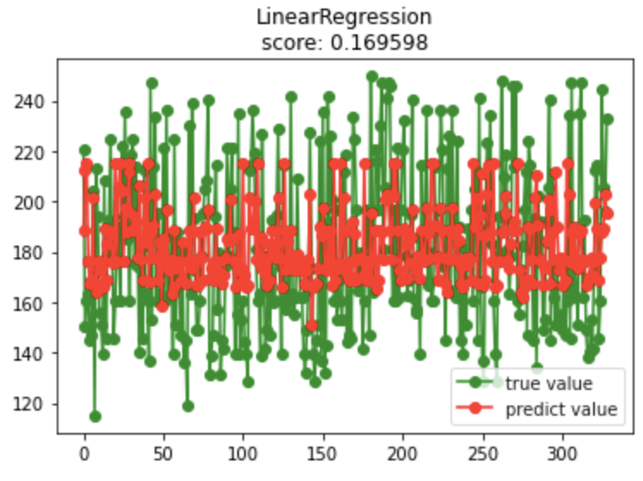
Before
After
Diagrams showing training result before we process the data(get rid of all the outliers)

Slide 14
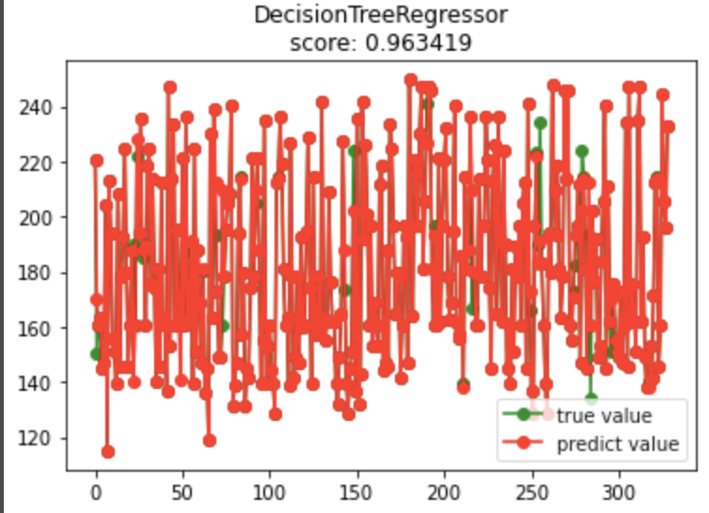
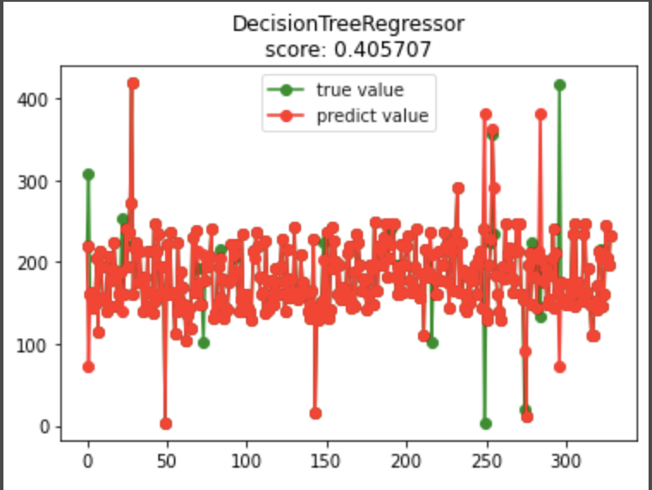
From the result from Tree model and Linear Regression, wse can conclude that our model is non-linear
Before
After
Diagrams showing training result before we process the data(get rid of all the outliers)

Slide 15
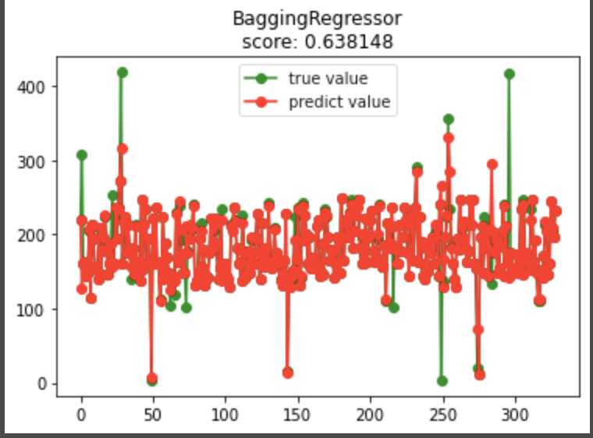
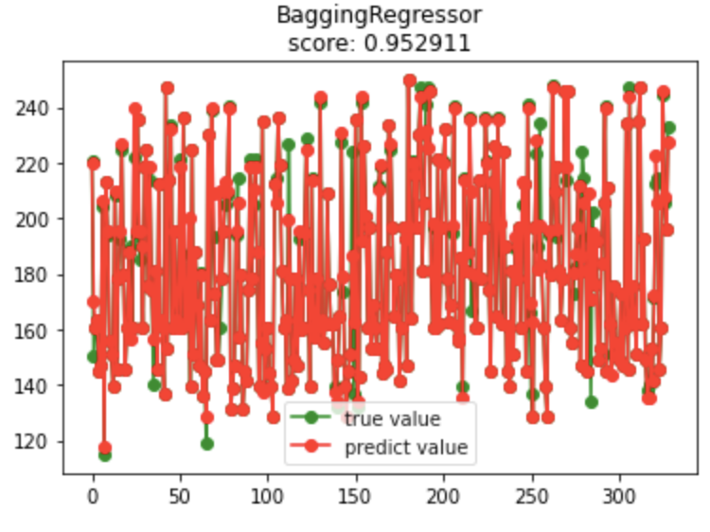
Ensemble method includes two averaging algorithms based on randomized decision tree, which is why Ensemble works well in non-linear data
Before
After
Diagrams showing training result before we process the data(get rid of all the outliers)

Slide 16
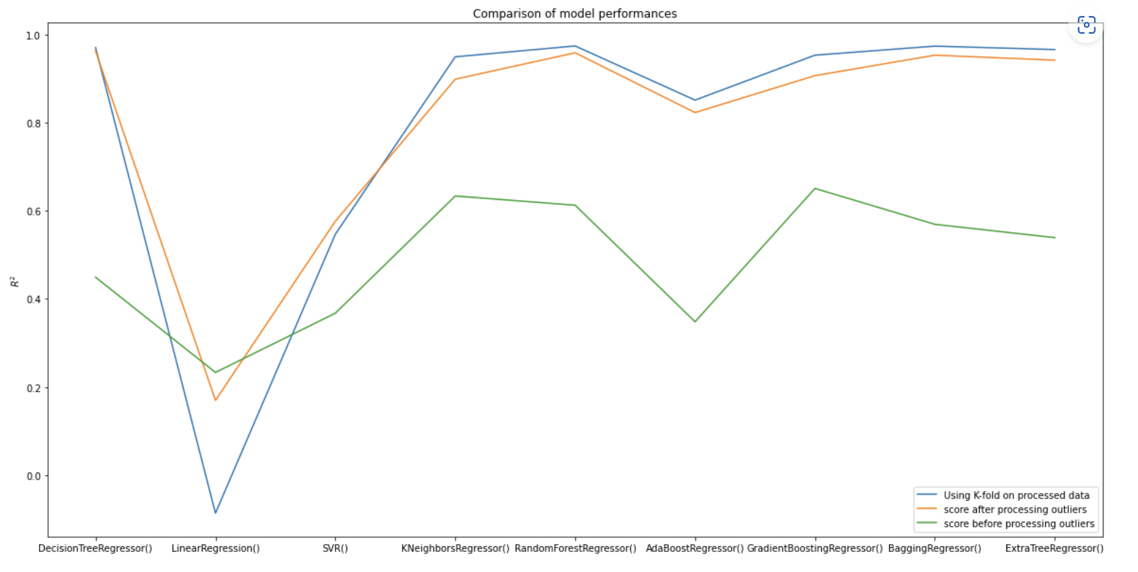
Processing outliers can generally improve the performance of ML models we select (except Linear Regression, probably some outliers improve data linearity)
K-fold can improve performances on Ensemble and Tree methods

Slide 17
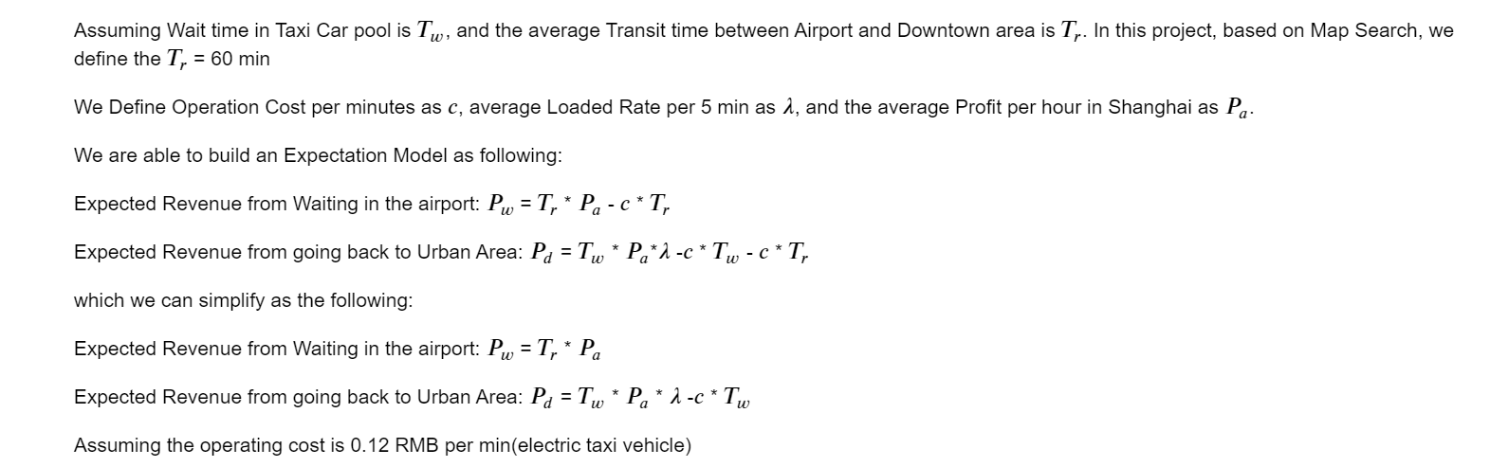
Profit comparing

Slide 18
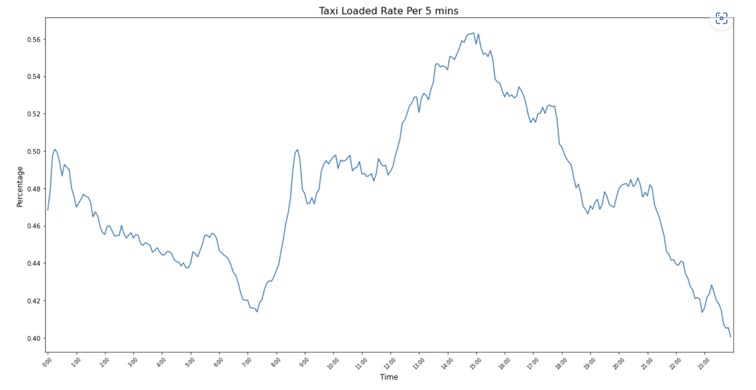

Slide 19
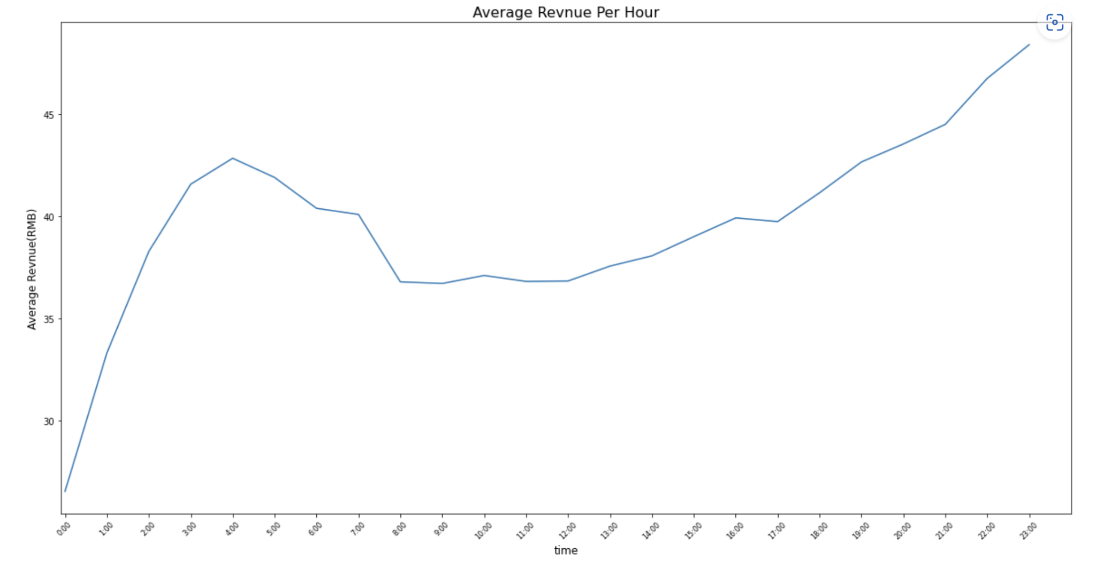

Slide 20
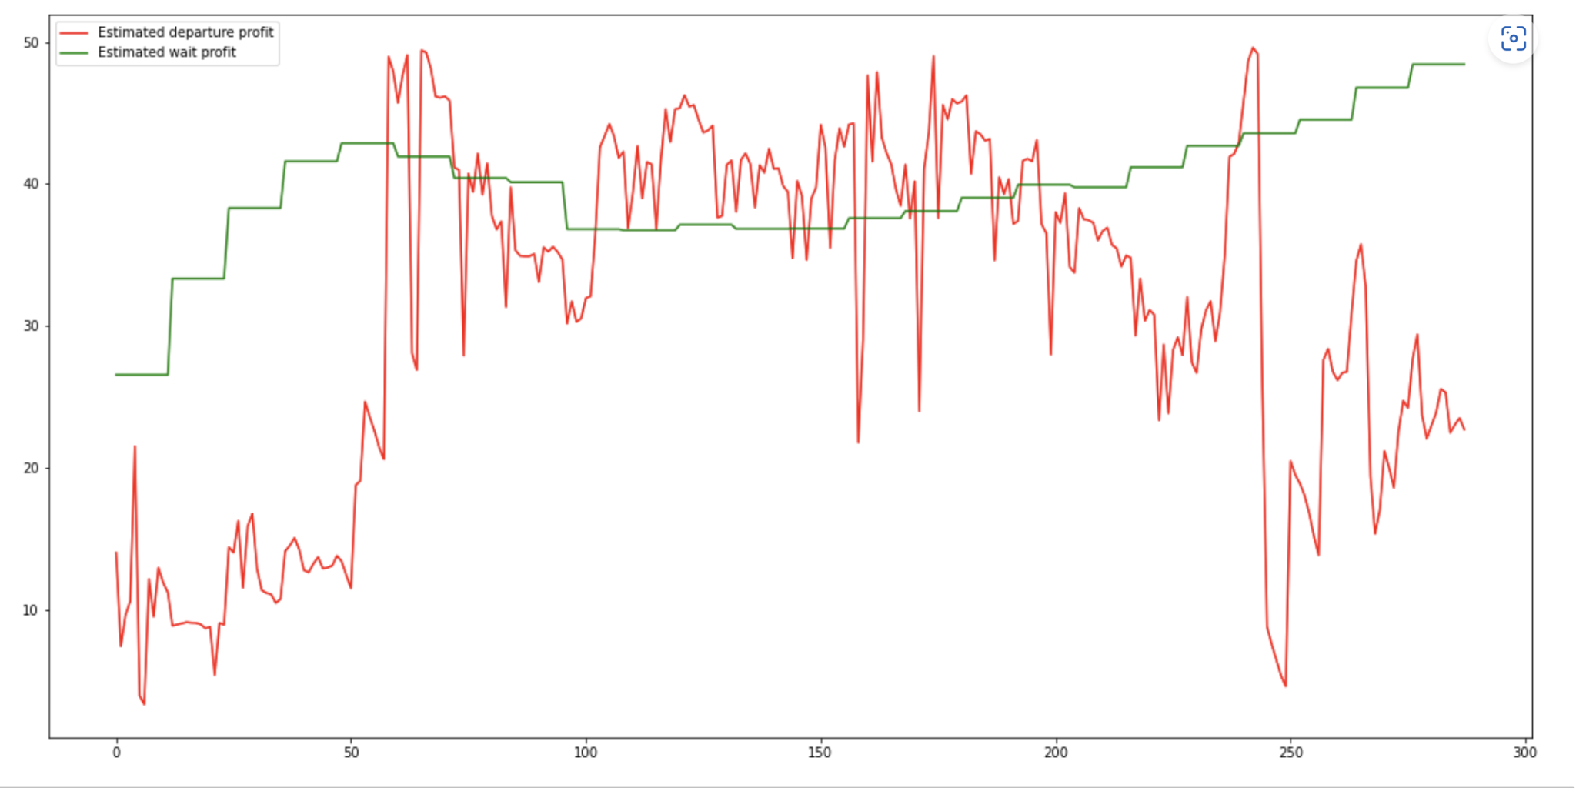
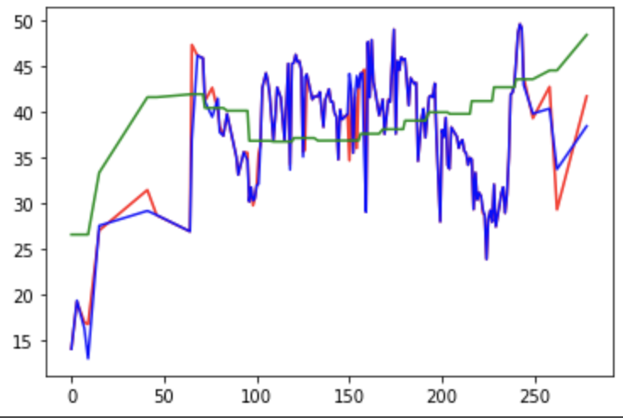
Ground truth visualization of the profit based on the whole data set
Testing data
Diagram showing the profit(s) using the ExtraTreeRegressor model
Blue (depart): prediction on training model
Green (to stay): prediction on training model

Slide 21
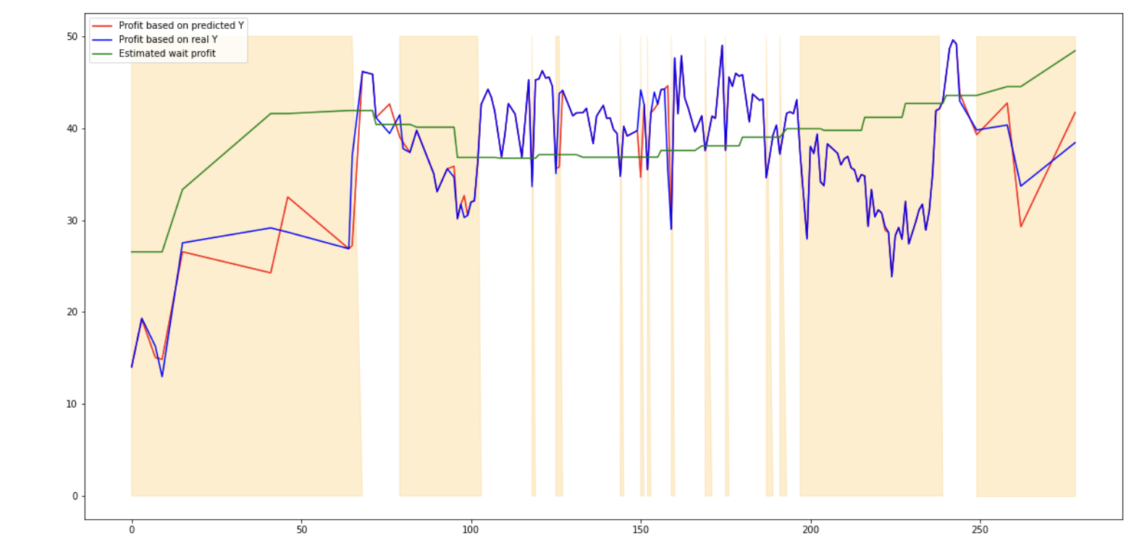
Final results gave the drivers the answers to stay and pick up the passengers early in the morning and late at night

Slide 22
Q&A?

Slide 23
Thank You!

